Slide 1
Key Elements of Learning Organizations: Applications for Juvenile Justice
Sarah Walker, Ph.D.
Jacqueline van Wormer, Ph.D.

Slide 2
Roadmap
2. Applications
3. Absorptive Capacity
2. Lessons from the Field
1. Mission and Metrics

Slide 3
Mission and Metrics
Notes:
The rapid pace of innovation through enhanced communication and technology means strategic plans that used to last for 5-10 years are now becoming obsolete with 2 years. To stay optimally effective, organizations should be reviewing how new knowledge and resources can enhance the orgs mission. But two key things need to be in place in order to plan for this – a clear mission statement and thoughtful metrics/indicators of success. Nature Conservancy mission was to preserve diversity in species by preserving natural habitat. Was very successful in raising money to preserve land from development and didn’t actively measure diversity in species, assuming that land preservation was impacting this other aspect of their mission. When they directly measured this, found that not only were species going extinct at the same or elevated levels. SAJE mission statement – finally landing on a feasible, meaningful role that we can play in the ecology.

Slide 4
Discussion
Mission | Impact | Activity | Capacity
Preserve public safety
Promote accountability
Promote youth rehabilitation/development
Notes:
Impact – directly measure the long term impact of your strategy.
Activity measures – measure progress towards program implementation. What you think are the key ingredients to get you to impact.
Capacity measures – measure your ability to get the previous things done. What do you need to have in place to get #1 and #2 done? Workforce, knowledge, funds, partnerships.

Slide 7
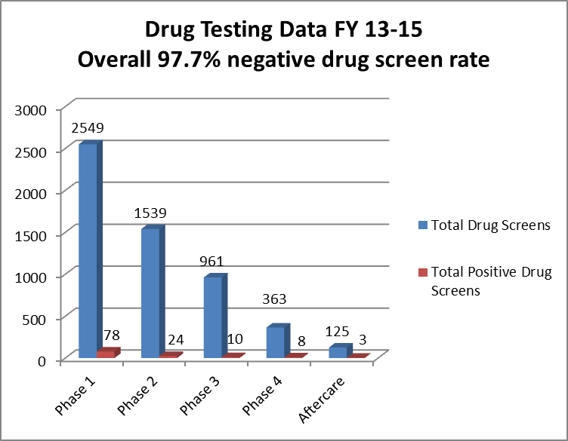
Phase 1: 96.9% negative drug screen rate.
Phase 2: 98.4% negative drug screen rate.
Phase 3: 98.9% negative drug screen rate.
Phase 4: 97.7% negative drug screen rate.
Aftercare: 97.6% negative drug screen rate.
Notes:
Speaker Notes:
Here is another example.
What can this data tell us about the youth in this program?
Look at the rates of negative drug screens! Do you have similar outcomes?
If you were to review this finding, what would you conclude?
Some responses might include:
Wrong kids
Drug testing issues

Slide 8
Continuous Quality Improvement
Collect
Analyze
Learneact
Collect: Gather data that is accurate, reliable, and directly related to a defined goal.
Analyze: Review data to determine if benchmarks are met. If expectations are not met, identify possible reasons why.
React: Learn from the data. Make an action plan to address shortcomings. Implement and monitor the plan.
Notes:
Speaker Notes:
This process of data collection is also referred to as Continuous Quality Improvement. The first step is for teams to meet to decide what are 4-5 basic data points that the team feels is most valuable to collect? The data you are collecting should be directly related to a program goal, such as “participants will show a marked reduction in recidivism, as compared to those that do not receive the intervention”
It is important that you are focused on the type of data to collect. It must be relevant to program outcomes and value added. You also want to make sure that the data you collect is accurate and reliable. The team must also decide how often they will review data? Monthly, quarterly, twice per year, etc?
The data should be presented in a format that is easily digestible for the team, stakeholders and community.
Teams also need to develop action plans, or use an GANNT chart to track changes that you will make to the program or services, based on the results of the analyses.

Slide 9
Please specify to what extent your agency uses external resources to obtain information (consultants, seminars, internet, journals, academic publications, and laws):
Question | Scale
The search for relevant information is an everyday business in our court . | Strongly disagree to Strongly Agree 1 2 3 4 5 6 7
Our management motivates employees to use information sources within the field of juvenile justice. | Strongly disagree to Strongly Agree 1 2 3 4 5 6 7
Our management expects that the employees deal with information beyond juvenile justice | Strongly disagree to Strongly Agree 1 2 3 4 5 6 7

Slide 10
Please specify to what extent the following statements fit the communication structure in your organization
Question | Scale
In our court ideas and concepts are summarized across departments | Strongly disagree to Strongly Agree 1 2 3 4 5 6 7
Our management emphasizes cross-department support to solve problems | Strongly disagree to Strongly Agree 1 2 3 4 5 6 7
In our company there is quick information flow and communicates this information promptly to other units | Strongly disagree to Strongly Agree 1 2 3 4 5 6 7
Our management demands periodical cross department meetings to interchange new developments, problems and achievements | Strongly disagree to Strongly Agree 1 2 3 4 5 6 7

Slide 11
Please specify to what extent the following statements fit the knowledge processing in your organization
Question | Scale
Our employees have the ability to structure and to use collected knowledge | Strongly disagree to Strongly Agree 1 2 3 4 5 6 7
Our employees are used to absorb new knowledge as well as to prepare it for purposes and to make it available | Strongly disagree to Strongly Agree 1 2 3 4 5 6 7
Our employees successfully link existing knowledge with new insights | Strongly disagree to Strongly Agree 1 2 3 4 5 6 7
Our employees are able to apply new knowledge in their practical work | Strongly disagree to Strongly Agree 1 2 3 4 5 6 7

Slide 12
Please specify to what extent the following statements fit the use of new knowledge
Question | Scale
Our management supports the development of new approaches | Strongly disagree to Strongly Agree 1 2 3 4 5 6 7
Our company regularly reconsiders technologies and approaches and adapts them according to new knowledge | Strongly disagree to Strongly Agree 1 2 3 4 5 6 7
Our organization has the ability to adopt new technologies and approaches | Strongly disagree to Strongly Agree 1 2 3 4 5 6 7

Slide 13
Lessons from the Field

Slide 14
Some examples

Slide 15
Evaluating Innovations
A family-based intervention developed to support African American families in promoting conflict resolution, substance use prevention and school engagement. The program shows a modest effect for justice involved youth on probation (risk unknown). Results shows 30% of the youth in the program improve attendance at school, 50% had no re-referrals to court within one year. When compared to a group randomized to generic family counseling, youth in the intervention were 33% less likely to reoffend (3/10 youth were less likely to reoffend).
Mission
Impact
Process
Capacity

