Slide 1
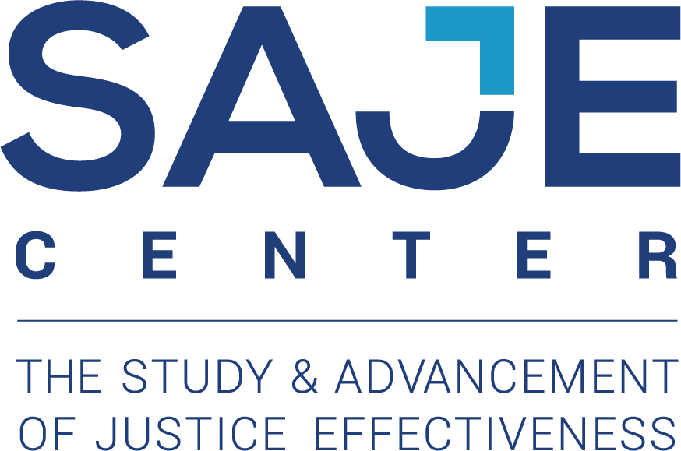
MECHANISMS OF CHANGE FOR SELECTIVE PREVENTION PROGRAMS IN JUVENILE COURTS: RESULTS FROM A FEMALE-SPECIFIC STUDY
Sarah Cusworth Walker, PhD¹
Asia Bishop, MSW, PhD Candidate
Leslie Leve, PhD
Mylien Duong, PhD
Noah Gubner, PhD¹
Emi Gilbert, BS¹
¹Department of Psychiatry, University of Washington School of Medicine
School of Social Work, University of Washington School of Medicine
College of Education, University of Oregon
Committee for Children
Special thanks to Kristin Vick, MPA¹

Slide 2
Mechanisms of Change
Background
The absolute number of juvenile arrests over the past 10 years continued its decline from the highs of the 1990’s
Girls arrests have declined at roughly similar levels to boys (53 vs 57%) with slower declines for some crimes: Drug violations (-33%); Crimes within family (-39%)
As girls’ arrests dropped at a slower pace, policymakers and advocates raised concerns about the inequitable and/or less responsive treatment girls were receiving as well as their unique pathways into justice involvement.
Girls have higher levels of family conflict, mental health needs, previous abuse, greater representation within status offenses.
Ehrmann, S., Hyland, N., & Puzzanchera, C. (2019). Girls in the Juvenile Justice System (Juvenile Justice Statistics: National Report Series Bulletin). Washington, DC: U.S. Department of Justice, Office of Juvenile Justice and Delinquency Prevention.

Slide 3
Mechanisms of Change
Implementation Context
Sustained implementation of female-specific programming is challenging in justice settings.
The 2008 OJJDP study group¹ found no female-specific program that met the highest standard of evidence-support out of 70 programs, with the majority not having sufficiently rigorous designs.
Difficulties with economy of scale, fluctuating numbers and within group heterogeneity.
How do we meet the calls for:
Gender responsive programming
Effective intervention
Implementation feasibility and sustainability
¹Zahn, M., Hawkins, S., Chiancone, J., & Whitworth, A. (2008). Girls Study Group: Charting the Way to Delinquency Prevention for Girls (OJJDP Girls Study Group Series). Washington, DC: U.S. Department of Justice, Office of Juvenile Justice and Delinquency Prevention.

Slide 4
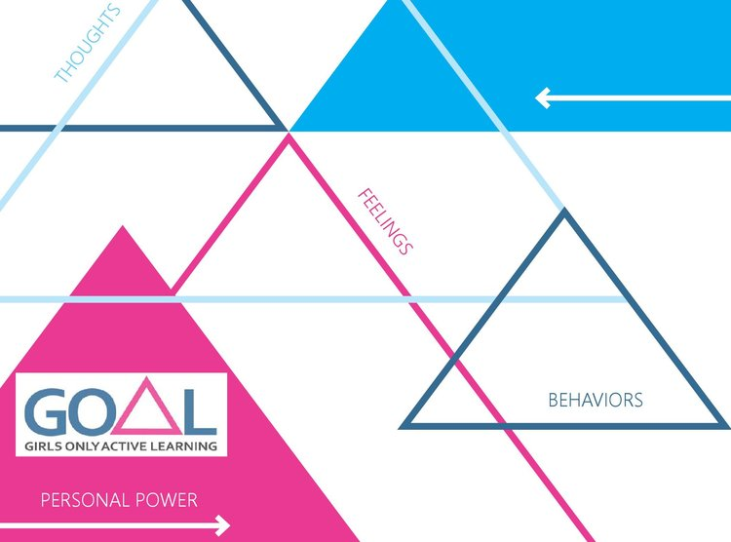
Mechanisms of Change
The Program
Girls Only Active Learning (GOAL)
POPULATION
Girls aged 13-17 involved in or at risk of involvement in the justice system
PROGRAM AIMS
Preventing delinquent behavior, recidivism, and substance use
OVERVIEW
Based on a cognitive-behavioral model of emotion and thought regulation, problem-solving, coping skills, and moral reasoning used by other CBT-based interventions for offenders and focuses on building and sustaining prosocial relationships and future goals

Slide 5
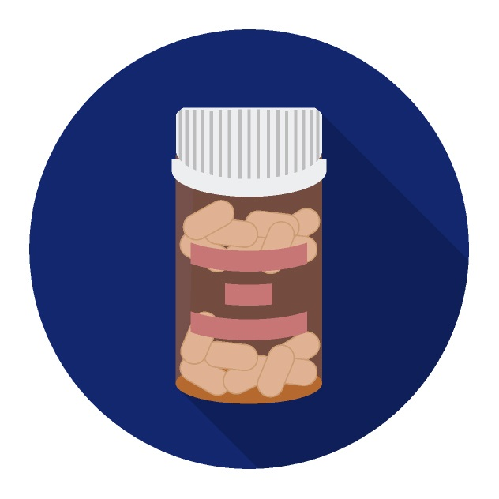
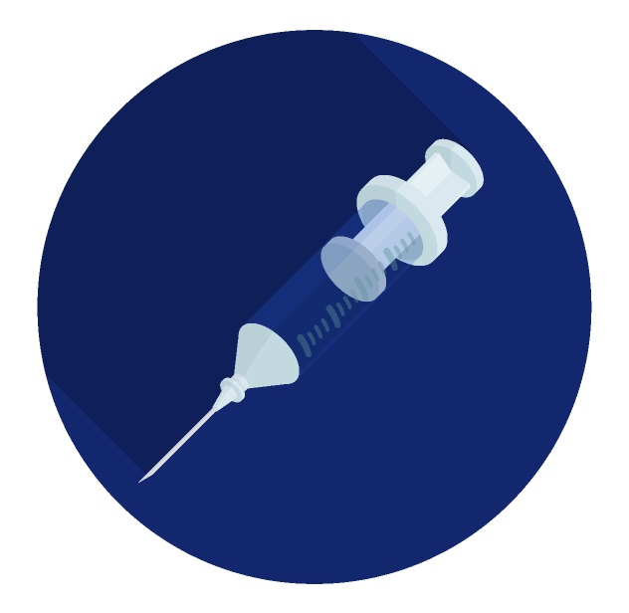
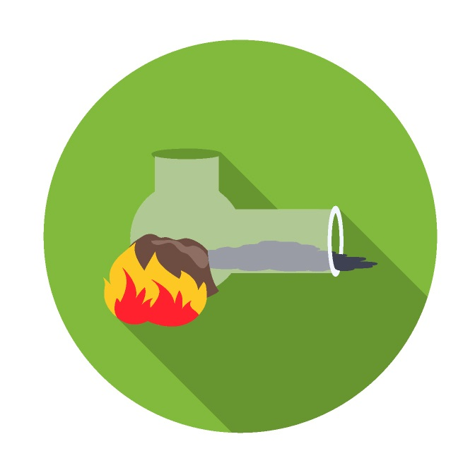
Mechanisms of Change
Relevant Theories
Relevant Theory: Preventing/Reducing Adolescent Substance Use
SOCIAL LEARNING THEORY^{1,2}
Drug use learned through modeling and reinforcement
Expected mediators: Modify normative expectations and incentives, skills for resisting social pressure to use, develop interpersonal skills to decrease motivation to use
SOCIAL DEVELOPMENT MODEL³
Positive socialization must occur across multiple units of socialization
Belonging, conforming activities, develop social bonds to convention
Expected mediators: Family environment, peer relationships
¹Bandura, A. (1977). Social learning theory (Prentice-Hall series in social learning theory). Englewood Cliffs, N.J.: Prentice Hall. ²Patterson et al., 1989 ³Catalano, R. & Hawkins, J. (1996). The Social Development Model: A Theory of Antisocial Behavior. In Delinquency and Crime: Current Theories (pp. 149-197). Cambridge: Cambridge University Press.

Slide 6
Mechanisms of Change
Effective Mechanisms
Literature on Effective Mechanisms
YOUTH-BASED (SOCIAL LEARNING)
Botvin, Schinke, Epstein, Diaz, & Botvin (1995)¹
Outcome: Intention and frequency of drinking
Significant mediators: Higher anti-drinking attitudes, refusal assertiveness, risk taking
FAMILY-BASED (SOCIAL LEARNING/SOCIAL DEVELOPMENT)
Systematic review by Benedini & Fagan (2016)²
Outcome: Youth antisocial behaviors (inclusive of drug/alcohol/delinquency)
Significant mediators (67% of studies): Parent supervision or discipline, parent/child cohesion, communication, and parent attitudes
Theoretical review by Bonell, Hinds, Dickson, Thomas et al. (2016)³
Outcome: Substance use/violence
Significant mediators: Theoretical synthesis - did not assess strength. Proposed that PYD theory of reduced substance use and violence may operate through modeling, reinforcement, internal self-regulation, and positive assets.
¹Botvin, G., Schinke, S., Epstein, J., Diaz, T., Botvin, E., & Cox, W. (1995). Effectiveness of culturally focused and generic skills training approaches to alcohol and drug abuse prevention among minority adolescents: Two-year follow-up results. Psychology of Addictive Behaviors, 9(3), 183-194. ²Fagan, A., & Benedini, A. (2016). How do family-focused prevention programs work? A review of mediating mechanisms associated with reductions in youth antisocial behaviors. Clinical Child and Family Psychology Review, 19(4), 285-309. ³Bonell, C., Dickson, K., Hinds, K., Melendez-Torres, G., Stansfield, C., Fletcher, A. . . . Campbell, R. (2016). The effects of Positive Youth Development interventions on substance use, violence and inequalities: Systematic review of theories of change, processes and outcomes. Public Health Research, 4(5), 1-218.

Slide 7
Mechanisms of Change
Gender Dimensions
Gender Dimensions Affecting Theory Application & Responsivity
Adolescent females (AF) who progress to drug/substance abuse and delinquency are more likely than adolescent males (AM) to have internalizing comorbodity¹ and histories of sexual abuse²
Youth prevention programs show poorer aggregated effects for AF than AM³
FEMINIST THEORY^{4,5}
Substance use and delinquency is attributed to socialized gender roles, structural oppression, vulnerability to abuse from males
Expected mediators: Internalizing coping strategies, awareness of and sense of efficacy to cope with structural bias
¹ Cauffman, E., Piquero, A. R., Broidy, L., Espelage, D. L., & Mazerolle, P. (2004). Heterogeneity in the association between social-emotional adjustment profiles and deviant behavior among male and female serious juvenile offenders. International Journal of Offender Therapy and Comparative Criminology, 48(2), 235-252. ²Adams, Z. W., McCart, M. R., Zajac, K., Danielson, C. K., Sawyer, G. K., Saunders, B. E., & Kilpatrick, D. G. (2013). Psychiatric problems and trauma exposure in non-detained delinquent and non-delinquent adolescents. Journal of Clinical Child and Adolescent Psychology, 42(3), 323-331. ³Fagan, A., & Lindsey, A. (2014). Gender differences in the effectiveness of delinquency prevention programs. Criminal Justice and Behavior, 41(9), 1057-1078.⁴Holsinger, K. (2000). Feminist perspectives on female offending: Examining real girls' lives. Women and Criminal Justice, 12(1), 23-51. ⁵Belknap, J., & Holsinger, K. (2013). The gendered nature of risk factors for delinquency. In Girls, Women, and Crime: Selected Readings (pp. 101-118). SAGE Publications.

Slide 8
Mechanisms of Change
Current Study: Hypotheses
Hypotheses
Intervention condition will be associated with decreases in emotional reactivity
Decreases in emotional reactivity will be associated with decreases in substance use
Models with emotional reactivity mediators will be significant and models with family conflict mediators will not be significant.

Slide 9
Mechanisms of Change
Study Characteristics
Study Characteristics
SITES
Five juvenile probation departments in Washington State (spanning urban to rural)
DESIGN
Quasi-experimental (time block assignment)
Program was offered 1-2 times a year at each site and girls who met eligibility in that timeframe were referred to intervention; those who met eligibility outside of that time frame were referred to treatment as usual
Baseline, 3 mo., 6 mo. waves measuring family climate, coping style (DERS), substance use, risk-taking

Slide 10
Mechanisms of Change
Mediation Analysis Plan
M (Mediator)
a
b
c’ = Direct effect of X on Y
ab = Indirect effect of X on y through M
Analysis Plan
Based on Fang & Schinke (2014)¹
Used FIML to handle missing data.
X (Predictor)
Y (Outcome)
c’
Direct (c’) and indirect pathways (ab) analyzed simultaneously.
MODEL INDIRECT command (Mplus) used to estimate the indirect effects from intervention assignment to SUD outcome². Separate mediation models will be run with mediators: family conflict, trouble, and acceptance.
Bias-corrected bootstrapping method (based on 2,000 samples) used (does not require normal distribution assumptions).
Mediation effects considered significate if bias-corrected 95% CI did not include zeros.
To control for baseline differences - baseline scores for the outcome and mediator variables were included in the models.
¹ Fang, L. & Schinke, S. (2014). Mediation effects of a culturally generic substance use prevention program for Asian American adolescents. Asian American Journal of Psychology, 5(2), 116-125.
²Fritz, M., & Mackinnon, D. (2007). Required sample size to detect the mediated effect. Psychological Science, 18(3), 233-239.

Slide 11
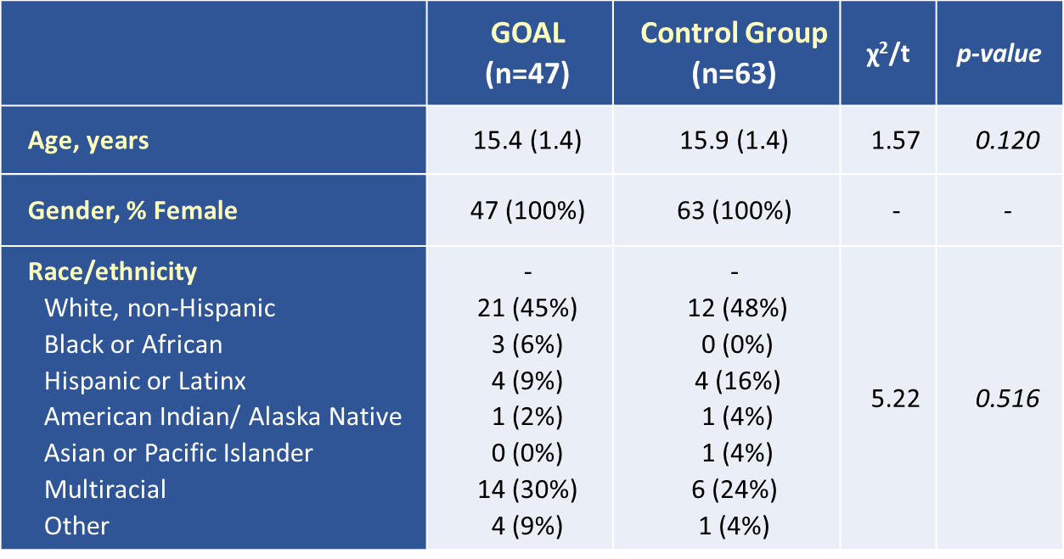
Mechanisms of Change
Demographics
Table 1. Demographics by group
Mean (standard deviation) for continuous variable, n (%) for categorical variables, * = p ≤ 0.05.

Slide 12
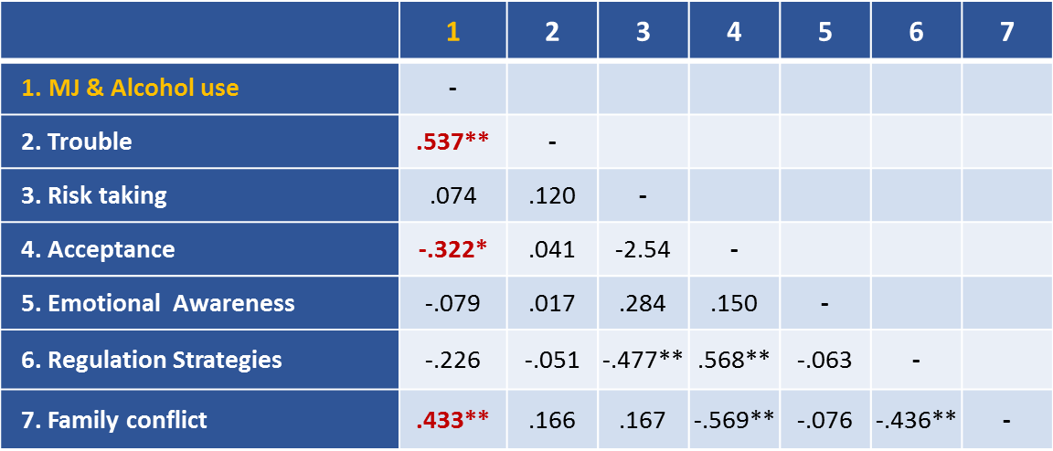
Mechanisms of Change
Bivariate Correlations
Table 2. Bivariate correlations between changes in behavior (T2-T1), emotional regulation, family climate, and youth demographics
Notes: All variables are presented as change scores calculated as time 2 (3 months) – time 1 (baseline). * p < .05, ** p < .01, *** p < .001. MJ & Alcohol use = a combined risk profile for using marijuana and alcohol. Delinquency/risk behaviors are coded towards risk; the DERS subscales are coded towards greater improvements in regulation skills; and the family items are mixed.

Slide 13
Mechanisms of Change
Mediation Model 1
T1 = at baseline
T2 = at 3 months
M (Mediator)
T1 variables for mediator and outcome added as controls
Family conflict
(at T2)
Mediation Model 1
(Family Conflict)
a = -0.180, p = 0.406
b = 0.778, p = 0.033*
Family conflict was associated MJ & Alc use at T2 (b = 0.778, p = 0.033*).
Group assignment was associated with MJ & Alc use at T2 (c’ = -1.910, p = 0.008**).
No evidence that family conflict was associated with group or that family conflict mediated the relationship between group and MJ & Alc use.
Intervention Assignment
(GOAL vs Comparison group)
MJ & Alc use
(at T2)
Direct effect of X on Y
c’ = -1.910, p = 0.008**
X (Predictor)
Y (Outcome)
Indirect effect of X on Y through M
ab = -0.140, p = 0.501 (bootstrap CI = -0.727, 0.131)

Slide 14
Mechanisms of Change
Mediation Model 2
T1 = at baseline
T2 = at 3 months
M (Mediator)
T1 variables for mediator and outcome added as controls
Trouble
(at T2)
Mediation Model 2
(Trouble)
a = -0.373, p = 0.047*
b = 1.147, p = 0.149
Group assignment was associated with Trouble (a = -0.373, p = 0.047*).
Group assignment was associated with MJ & Alc use at T2 (c’ = -1.553, p = 0.028*).
There was no evidence that trouble was associated with MJ & Alc use or that it mediated the relationship between group and MJ & Alc use.
Intervention Assignment
(GOAL vs Comparison group)
MJ & Alc use
(at T2)
Direct effect of X on Y
c’ = -1.553, p = 0.028*
X (Predictor)
Y (Outcome)
Indirect effect of X on Y through M
ab = -0.427, p = 0.110 (bootstrap CI = -1.203, -0.043)

Slide 15
Mechanisms of Change
Mediation Model 3
T1 = at baseline
T2 = at 3 months
M (Mediator)
T1 variables for mediator and outcome added as controls
Acceptance
(at T2)
Mediation Model 3
(Acceptance)
a = -0.159, p = 0.525
b = -0.621, p = 0.124
Group assignment was associated with MJ & Alc use at T2 (c’ = -2.099, p = 0.005**).
There was no evidence that acceptance was associated with MJ & Alc use or group, or that acceptance mediated the relationship between group and MJ & Alc use.
Intervention Assignment
(GOAL vs Comparison group)
MJ & Alc use
(at T2)
Direct effect of X on Y
c’ = -2.099, p = 0.005**
X (Predictor)
Y (Outcome)
Indirect effect of X on Y through M
ab = 0.099, p = 0.573 (95% bootstrap CI = -0.145, 0.597)

Slide 16
Mechanisms of Change
Facilitator/Youth Feedback
KEY THEMES | CODES | CODE DESCRIPTIONS | COUNT | EXAMPLE QUOTES
Facilitator Interviews
Youth valued learning new skills | Participant engagement | Facilitators state explicit satisfaction with level of engagement in activities and usage of workshop skills during participation | 14 | "Girls Pledge provoked thoughtful discussion" "Girls were engaged"
Youth most engaged in sessions discussing relationships & crafts | Participant satisfaction | Participants liked and/or were satisfied with activities | 6 | "Girls liked the crafts activity" "Healthy relationships resonated with the girls"
Youth Focus Groups
Youth found program (CB) skills helpful | Feelings, Emotion-regulation | Discussions of emotion-regulation skills developed in GOAL | 17 | "The way we can deal with someone's anger, they helped us with that." "[The coping skills] were really helpful because I get mad a lot"
 | Role play | Appreciation of role play as a skill building activity | 10 | "We did like the role playing which wasn't that boring" "There was a bunch of laughing […]during the role plays"
 | Effort | Feeling that their time and/or efforts was validated through acquiring substantive, tangible skills | 8 | "We really worked on stuff that we can really see" "It wasn't ever boring or confusing to me […] all the time was filled up in a good way" "It didn't really feel like you were getting that much practice through the homework […] it wasn't helping you understand how it worked"
 | Continuing education | Desire to have learning take place inside classroom, or for peers to experience learning | 5 | "I mean, in school they obviously don't teach you any of this and they should"
 | Rebuilding relationships | Discussion of using skills to reconnect, or the desire to reconnect | 3 | "I was able to rebuild the connections with my parents"
Group environment was supportive | Changing expectations | How GOAL turned out to be different than participants expected | 3 | "At first you think it's all bad until you actually get into it and it's helpful"
 | Safe environment | How GOAL provided a safe space | 11 | "You can let your guard down because you don't have to worry about anything here"
 | Comfortable environment | How GOAL provided a comfortable atmosphere | 9 | "It's just not having the fear of someone making fun of you because we've all been through the same sort of thing" "I just felt comfortable with the group and stuff and they just taught me a lot to open up"
 | Facilitators | Appreciation of the GOAL facilitators | 9 | "K and V were really good teachers for us"
 | Maintaining privacy | Appreciation of personal privacy in the group setting, often expressed through an apprehension to share | 8 | "I did not want to share my personal life" "Not being forced to talk about your personal stuff if you really don't want to"

Slide 17
Mechanisms of Change
Conclusions & Next Steps
Our study hypotheses were only partially supported
While we observed direct effects of GOAL on behavioral outcomes (“MJ/Alcohol Use” and “Getting into Trouble”), we did not observe any mediated effects
Only “Family Conflict” was associated with lower “MJ/Alcohol Use”
Youth and facilitator feedback suggested areas of most perceived benefit/impact were in relationships, particularly family relationships.
TENTATIVE CONCLUSION
Family climate may be a stronger influence on girls’ substance use than emotional reactivity.
NEXT STEPS
We will run models looking at how changes in mediators at 3 months are associated with outcomes at 6 months.

